Slide 1

William Stallings Computer Organization and Architecture 8th Edition
Chapter 15
Control Unit Operation

Slide 2
Micro-Operations
A computer executes a program
Fetch/execute cycle
Each cycle has a number of steps
see pipelining
Called micro-operations
Each step does very little
Atomic operation of CPU

Slide 3
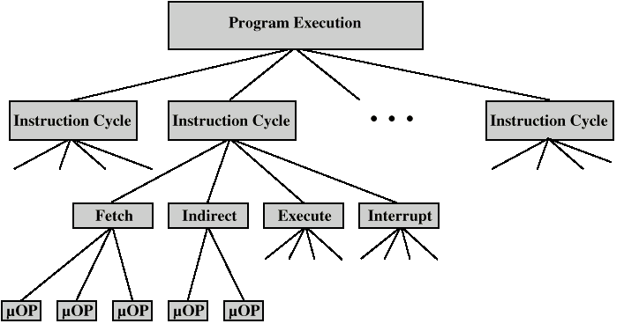

Constituent Elements of Program Execution

Slide 4
Fetch - 4 Registers
Memory Address Register (MAR)
Connected to address bus
Specifies address for read or write op
Memory Buffer Register (MBR)
Connected to data bus
Holds data to write or last data read
Program Counter (PC)
Holds address of next instruction to be fetched
Instruction Register (IR)
Holds last instruction fetched

Slide 5
Fetch Sequence
Address of next instruction is in PC
Address (MAR) is placed on address bus
Control unit issues READ command
Result (data from memory) appears on data bus
Data from data bus copied into MBR
PC incremented by 1 (in parallel with data fetch from memory)
Data (instruction) moved from MBR to IR
MBR is now free for further data fetches

Slide 6
Fetch Sequence (symbolic)
t1: MAR <- (PC)
t2: MBR <- (memory)
PC <- (PC) +1
t3: IR <- (MBR)
(tx = time unit/clock cycle)
or
t1: MAR <- (PC)
t2: MBR <- (memory)
t3: PC <- (PC) +1
IR <- (MBR)

Slide 7
Rules for Clock Cycle Grouping
Proper sequence must be followed
MAR <- (PC) must precede MBR <- (memory)
Conflicts must be avoided
Must not read & write same register at same time
MBR <- (memory) & IR <- (MBR) must not be in same cycle
Also: PC <- (PC) +1 involves addition
Use ALU
May need additional micro-operations

Slide 8
Indirect Cycle
MAR <- (IR_{address}) - address field of IR
MBR <- (memory)
IR_{address} <- (MBR_{address})
MBR contains an address
IR is now in same state as if direct addressing had been used
(What does this say about IR size?)

Slide 9
Interrupt Cycle
t1: MBR <-(PC)
t2: MAR <- save-address
PC <- routine-address
t3: memory <- (MBR)
This is a minimum
May be additional micro-ops to get addresses
N.B. saving context is done by interrupt handler routine, not micro-ops

Slide 10
Execute Cycle (ADD)
Different for each instruction
e.g. ADD R1,X - add the contents of location X to Register 1 , result in R1
t1: MAR <- (IR_{address})
t2: MBR <- (memory)
t3: R1 <- R1 + (MBR)
Note no overlap of micro-operations

Slide 11
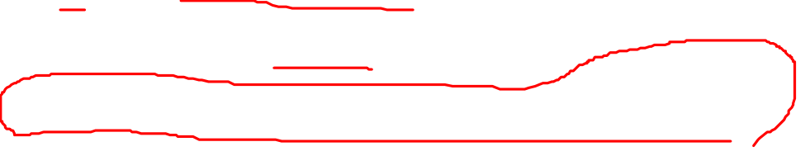
Execute Cycle (ISZ)
ISZ X - increment and skip if zero
t1: MAR <- (IR_{address})
t2: MBR <- (memory)
t3: MBR <- (MBR) + 1
t4: memory <- (MBR)
if (MBR) == 0 then PC <- (PC) + 1
Notes:
if is a single micro-operation
Micro-operations done during t4

Slide 12

Execute Cycle (BSA)
BSA X - Branch and save address
Address of instruction following BSA is saved in X
Execution continues from X+1
t1: MAR <- (IR_{address})
MBR <- (PC)
t2: PC <- (IR_{address})
memory <- (MBR)
t3: PC <- (PC) + 1

Slide 13
Instruction Cycle
Each phase decomposed into sequence of elementary micro-operations
E.g. fetch, indirect, and interrupt cycles
Execute cycle
One sequence of micro-operations for each opcode
Need to tie sequences together
Assume new 2-bit register
Instruction cycle code (ICC) designates which part of cycle processor is in
00: Fetch
01: Indirect
10: Execute
11: Interrupt

Slide 14
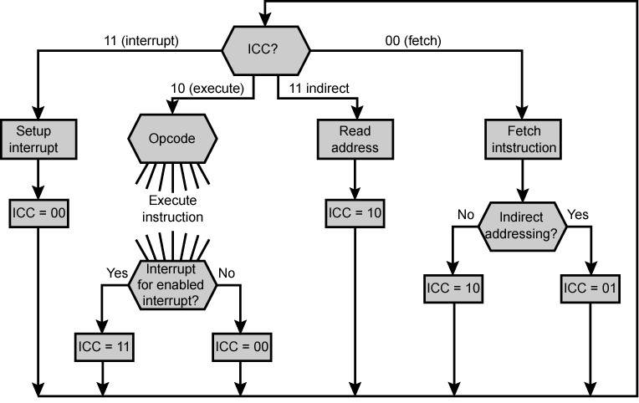
Flowchart for Instruction Cycle

Slide 15
Functional Requirements
Define basic elements of processor
Describe micro-operations processor performs
Determine functions control unit must perform

Slide 16
Basic Elements of Processor
ALU
Registers
Internal data pahs
External data paths
Control Unit

Slide 17
Types of Micro-operation
Transfer data between registers
Transfer data from register to external
Transfer data from external to register
Perform arithmetic or logical ops

Slide 18
Functions of Control Unit
Sequencing
Causing the CPU to step through a series of micro-operations
Execution
Causing the performance of each micro-op
This is done using Control Signals

Slide 19
Control Signals
Clock
One micro-instruction (or set of parallel micro-instructions) per clock cycle
Instruction register
Op-code for current instruction
Determines which micro-instructions are performed
Flags
State of CPU
Results of previous operations
From control bus
Interrupts
Acknowledgements

Slide 20
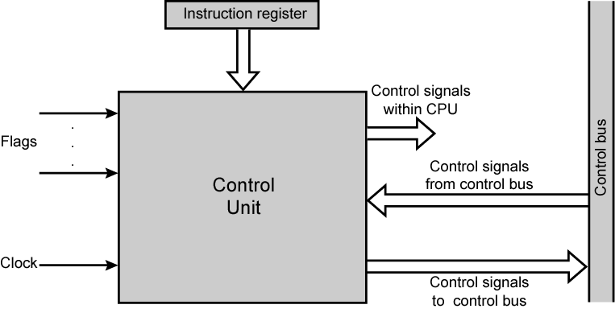
Model of Control Unit

Slide 21
Control Signals - output
Within CPU
Cause data movement
Activate specific functions
Via control bus
To memory
To I/O modules

Slide 22
Example Control Signal Sequence - Fetch
MAR <- (PC)
Control unit activates signal to open gates between PC and MAR
MBR <- (memory)
Open gates between MAR and address bus
Memory read control signal
Open gates between data bus and MBR

Slide 23
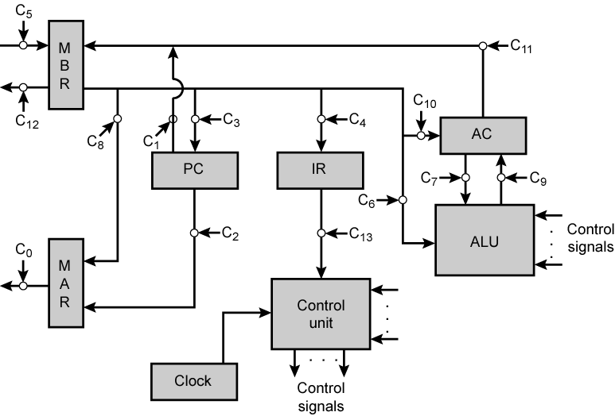
Data Paths and Control Signals

Slide 24
Internal Organization
Usually a single internal bus
Gates control movement of data onto and off the bus
Control signals control data transfer to and from external systems bus
Temporary registers needed for proper operation of ALU

Slide 25
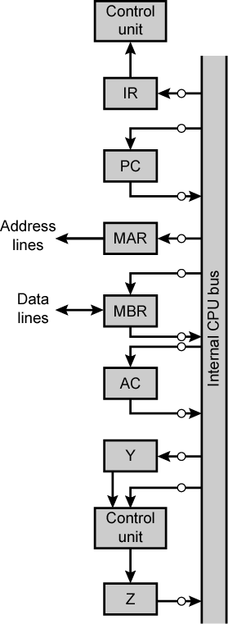

CPU with Internal Bus

Slide 26
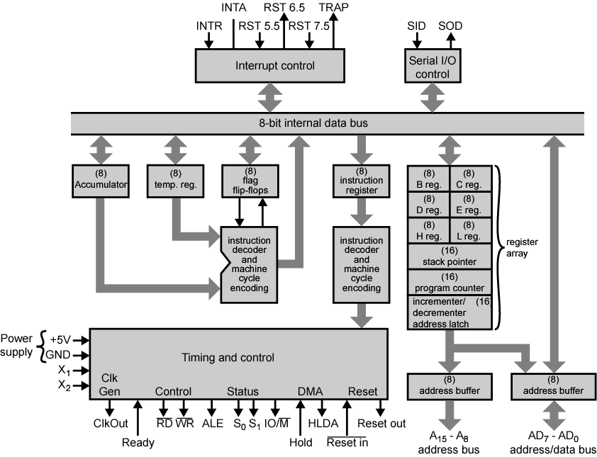

Intel 8085 CPU Block Diagram

Slide 27
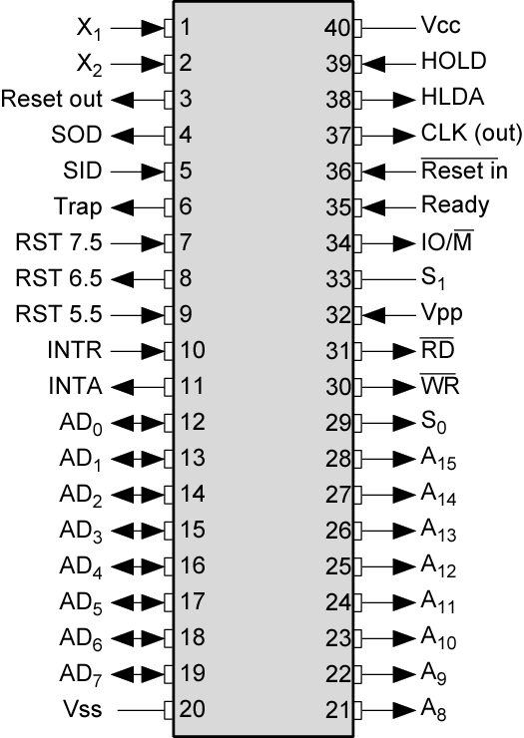
Intel 8085 Pin Configuration

Slide 28
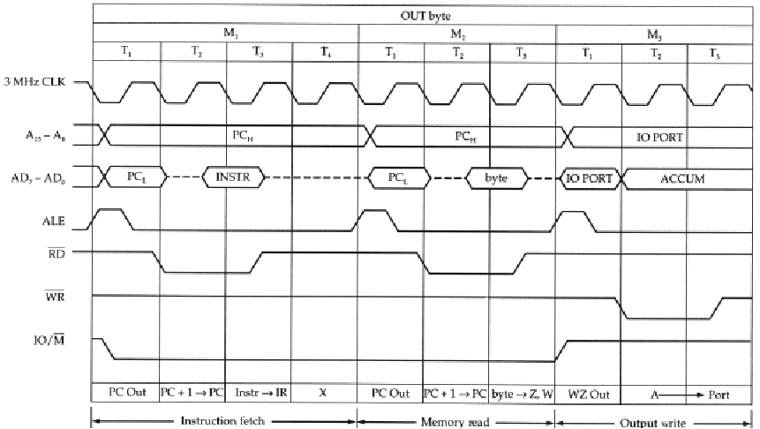
Intel 8085 OUT Instruction Timing Diagram

Slide 29
Hardwired Implementation (1)
Control unit inputs
Flags and control bus
Each bit means something
Instruction register
Op-code causes different control signals for each different instruction
Unique logic for each op-code
Decoder takes encoded input and produces single output
n binary inputs and 2^{n} outputs

Slide 30
Hardwired Implementation (2)
Clock
Repetitive sequence of pulses
Useful for measuring duration of micro-ops
Must be long enough to allow signal propagation
Different control signals at different times within instruction cycle
Need a counter with different control signals for t1, t2 etc.

Slide 31
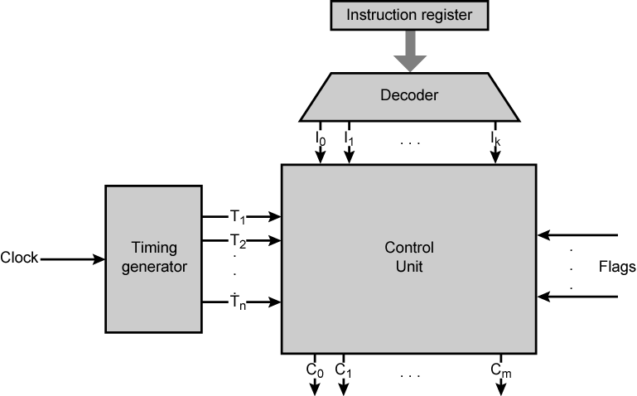
Control Unit with Decoded Inputs

Slide 32
Problems With Hard Wired Designs
Complex sequencing & micro-operation logic
Difficult to design and test
Inflexible design
Difficult to add new instructions

Slide 33
Required Reading
Stallings chapter 15

